Slide 1






Kia ora welcome to our webinar
Thanks for joining us. Your camera and mic are turned off, but once the session starts you can interact with the team
Microsoft Teams users:
We recommend you use Slido:
Web browsers (no app):
Go to Slido.com and enter in the code: 762020
Alternatively, you can join using this QR code with your mobile
Ask questions
through Q&A tab
React to comments
by pressing the ‘thumbs up’
To turn on live captions press the ‘more’ tab and select ‘turn on live captions’
Ask questions during the webinar by emailing: engagement@ccc.govt.nz
When you ask a question, it will be answered by a moderator. You will either get a written answer or an indication that something will be verbally answered so keep Slido open

Slide 2
Residential Intensification
Housing and Business Choice – Plan Change 14

Slide 3
What we’re going to cover
Introductions and webinar format
How to participate
Overview of legislative changes
Scope of plan change
Proposed zoning
Proposed residential precincts
Residential and urban design controls
Making feedback & decision making
Wrap up

Slide 4
Introductions and webinar format
Your presenters this evening
Ike Kleynbos – Senior Policy Planner
David Hattam – Senior Urban Designer
Format for the session
Thanks for your questions – will be answered in the presentation
Mics and videos are off to keep the session flowing
We’ll pause for questions throughout the presentation
Mop-up questions at the end

Slide 5
How to participate
Q&A
Teams app – can ask questions
on Q&A tab
Not on app – email questions to engagement@ccc.govt.nz
Questions moderated
Answers posted in chat
Slido
Go to Slido.com and enter in the code: 762020
Alternatively, you can join using this QR code with your mobile
Reactions
Thumbs up to show support
  In the chat (for questions and answers)
  In the tab at the top (for speakers)
Live captions
Turn on in the … (‘more’) tab

Slide 6
Overview of plan change and legislation

Slide 7
We need to make changes to our District Plan
Our population is growing and changing – we need more homes and more variety.
Need to plan for growth to protect productive land, environment and our lifestyle, while providing affordable housing.
Government’s National Policy Statement on Urban Development (NPS-UD) and the Resource Management (Enabling Housing Supply and Other Matters) Amendment Act allows more development.
Opportunity to shape how and where our city grows. What we get to decide for Ōtautahi-Christchurch:
  How much higher do we want to go?
  Where do we want to concentrate growth?

Slide 8
What the new legislation means
Up to 12m housing (about three storeys) across most of the city, and up to three houses per section, without requiring a consent – known as MDRS (Medium Density Residential standards).
MDRS must apply to all ‘relevant’ residential zones within the ‘urban environment’ – both set.
We have to allow more housing to be built, especially around commercial centres (NPS-UD).
Situations when developments require neighbour approval and rules for subdivisions needs to change – we have to allow more development.
We can identify Qualifying Matters in areas that are unsuitable for increased housing – they aren’t a way to stop all intensification.

Slide 9
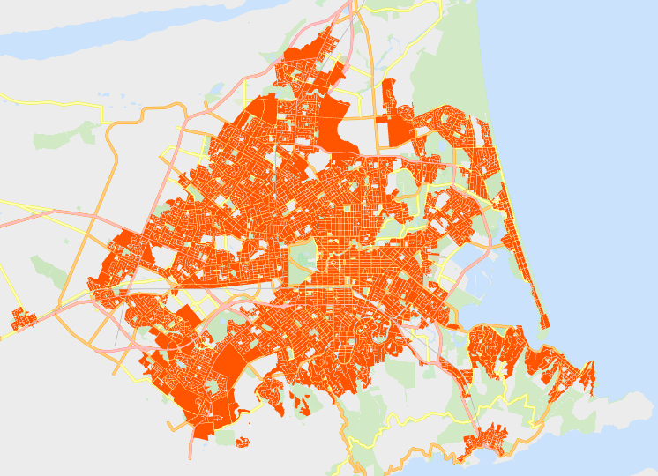
Summary of overall scope
Areas within scope:
  All urban residential zones, incl. associated Qualifying Matters
  Commercial centres & surrounds
  Other associated controls (subdivision, fencing, engineering, access, etc)
Areas outside of scope:
  Anything outside of urban environment
  New greenfield areas, incl. rural zones
  Non-residential activities

Slide 10
Summary of residential scope - MDRS
Current residential zones within scope:
  Current residential zones outside of scope:
Residential suburban zone Residential new neighbourhood zone Residential Banks Peninsula zone (any within urban environment) Residential hill zone | Residential suburban density transition zone Residential medium density zone Residential city centre zone
Residential large lot zone Residential small settlement zone Residential guest accommodation zone | Residential Banks Peninsula zone (any outside urban environment) Papakāinga/Kāinga Nohoanga Zone

Slide 11
Summary of scope – NPS-UD
Requirement to intensify within and adjacent to commercial centres and the CBD
Requirement to intensify to at least six storeys within at least a walkable catchment from CBD and Metropolitan Centres
  Walkable is generally considered to be 400m = 5 minute walking time
  Advice is minimum of 10min walking distance, increasing based on accessibility to amenities and housing demand
Requirement to intensity within and adjacent to suburban commercial centres, being: neighbourhood centre zones, local centre zones, and town centre zones (or equivalent)
  Proportionate to level of commercial activity and community services

Slide 12
Qualifying Matters
We can use Qualifying Matters to reduce intensification in some areas – however, they aren’t a way to negate any/all intensification.
They only apply in areas of MDRS intensification and NPS-UD intensification areas (commercial & residential). Standard overlays can manage features elsewhere.
There’s a high threshold for inclusion as a Qualifying Matter, with strong evidence required.

Slide 13
Qualifying Matters – our proposal
Most constraint features in current District Plan, for example:
Outstanding landscapes, vegetation, heritage, and cultural features
Utility & infrastructure related overlays: railway; Lyttelton Port; Airport; State Highway
High risk natural hazard areas (only): Rockfall; slope hazard; tsunami inundation; high flood risk
New matters:
400v power line setback
Lyttelton CityDepot – Hillsborough
Residential Heritage Areas, and new items & settings (PC13)
Radio Corridors (Justice & Emergency Services Precinct)
Coastal Hazards
‘Other matters’ we’re proposing to progress with:
Residential Character Areas
Vacuum Sewer Constraints
Schedule of Protected Trees

Slide 14
The process …
Some aspects of the NPS-UD/Enabling Act will take legal effect from here e.g. MDRS
UD&T agrees to pre-notification engagement
Public provides feedback
We analyse feedback, make changes, recommend notification
Council agrees to notification
Public provides written submissions
March 2022
April-May 2022
By 20 August 2022
We provide summary of submissions
Provisions come into effect
The Council agrees to recommendation
By 20 August 2023
Independent Hearings Panel makes recommendations to the Council
Independent Hearings Panel convenes Hearings
Public provides further written submissions
Minister for the Environment makes a determination on rejected recommendations
The Council does not agree to recommendation
Likely early 2023
Provisions are shelved
Notes:
This simplified process chart is further to the briefing of 8 February, where you asked for more clarity on the process – especially beyond notification.
Confirm the aspects of the NPS-UD / RM Amendment Act that will take effect at notification: MDRS; heritage provisions; qualifying matters.
Note to written submissions vs the timeline for provisions coming into legal effect: There is no bar against people making submissions against the MDRS rules, but the submission will be pointless because the Act requires the Council to include the MDRS in every residential zone (s77G(1)). The IHP does not have the option of leaving them out. The IHP will be able to consider submissions that the District Plan should be more lenient than the MDRS.

Slide 15
Questions?
Do you have any questions about the government legislation?
    The Council cannot change the legislation, but we can help you understand it.
Go to Slido.com and enter in the code: 762020
Alternatively, you can join by scanning this QR code

Slide 16
Proposed Residential Controls
Zones, Precincts, and urban design

Slide 17
Zone overview
Medium Density Residential Zone
Applies across all* urban residential area
Gives effect to MDRS, with additional controls
Permitted without consent to build up to 3 dwellings at 12m (3-4 storey) high for all* residential lots
Enabling consent up to 14m
High Density Residential Zone
Applies around all commercial centres, except Local Centres
Up to 14m (~4 storeys) can be achieved without consent, plus 3 dwellings per site (MDRS)
Enabling consent at 6 storeys (20m) for most of zone, via precincts
10 storeys enabled around CBD

Slide 18
Precincts overview
Used to respond to local features
Apply as an overlay to further nuance underlying zone controls
Suburban Centre Precincts:
  Local Centre
  Large Local Centre
  Town Centre
  Emerging Metropolitan Centre
Precinct for outer CBD Residential living:
  High Density Residential Precinct
Greenfield Precinct:
  Financial contribution to incentivise efficient land use
Residential Hills Precinct:
  Minimum vacant subdivision at 650m2 and hill earthworks
Waste Water Constraint Precinct:
  Vaccum sewer constraint

Slide 19
Suburban Centres Approach
Intensification directed within and surrounding suburban centres
Degree must respond to scale of commercial activity and community services provided for
Centres hierarchy required to be evaluated, with National Planning Standards alignment
Centre Type | Location | Extent | Enabled Height
Neighbourhood Centre & Local Centre | Addington; Fendalton; Edgeware; Parklands; Woolston; St Martins, etc. | Centre only | MDRS – 12m
‘Large’ Local Centre | Bishopdale; Barrington; Prestons - only | 200m | 14m – four storeys
‘Significant’ Local Centre | Merivale & Sydenham - only | 400m | 20m – six storeys
Town Centre | Church Corner; Linwood; North Halswell, etc. | 400m | 20m – six storeys
‘Emerging’ Metropolitan Centre | Riccarton; Hornby; Papanui - only | 600m | 20m – six storeys
Notes:
NPS-UD direction – what it sets out to achieve
Requirements of us as a Tier 1 council (re MDRS) - what we have to do to meet the Medium Density Residential Standards
Timeline – refer Intensification Streamlined Planning Process – the timeline for giving effect to the NPS-UD has been brought forward by a year
Facts / assumptions underpinning housing sufficiency (what the demand/supply facts tell us)
What can be considered as qualifying matters?
What’s in and out of these plan changes – the givens and what can’t be changed
‘Well functioning urban environment’ – what it means and how we give effect to it
Importance of meeting high evidential thresholds to support proposed changes
What and how does it affect Christchurch (c.f. current District Plan)
Permitted level? (Query whiteboard notes: is this about how high can we go?
Relevant residential zones? (Query whiteboard notes: is this about what happens to these zones now?) How much info do we have on this? This might take more than 10 mins on its own?
E.g. 3 storeys becomes the permitted level (with no resource consent needed). Any application for 4+ storeys will need a RC, but the impact is only assessed as the difference between 3 and 4 storeys, rather than the impact of a 4 storey bldg.

Slide 20
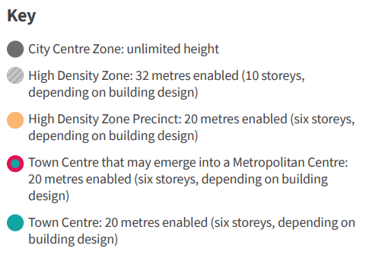
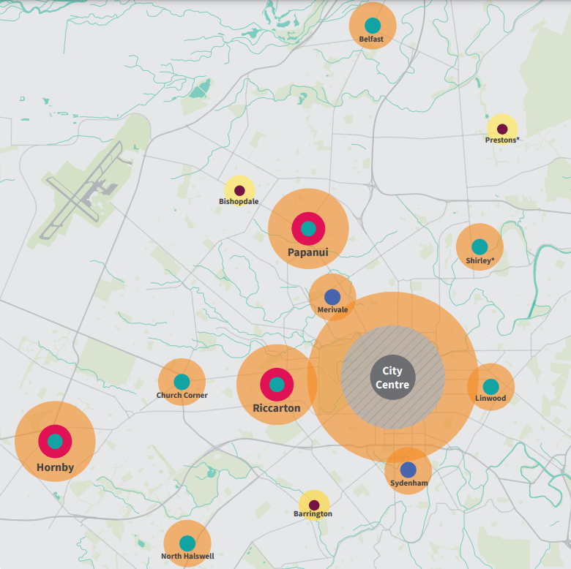
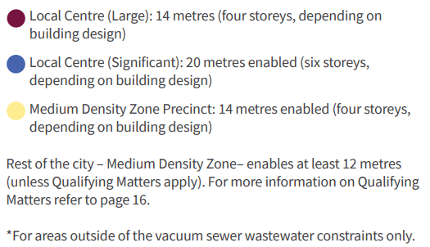
Suburban Centres Approach
Notes:
NPS-UD direction – what it sets out to achieve
Requirements of us as a Tier 1 council (re MDRS) - what we have to do to meet the Medium Density Residential Standards
Timeline – refer Intensification Streamlined Planning Process – the timeline for giving effect to the NPS-UD has been brought forward by a year
Facts / assumptions underpinning housing sufficiency (what the demand/supply facts tell us)
What can be considered as qualifying matters?
What’s in and out of these plan changes – the givens and what can’t be changed
‘Well functioning urban environment’ – what it means and how we give effect to it
Importance of meeting high evidential thresholds to support proposed changes
What and how does it affect Christchurch (c.f. current District Plan)
Permitted level? (Query whiteboard notes: is this about how high can we go?
Relevant residential zones? (Query whiteboard notes: is this about what happens to these zones now?) How much info do we have on this? This might take more than 10 mins on its own?
E.g. 3 storeys becomes the permitted level (with no resource consent needed). Any application for 4+ storeys will need a RC, but the impact is only assessed as the difference between 3 and 4 storeys, rather than the impact of a 4 storey bldg.

Slide 21
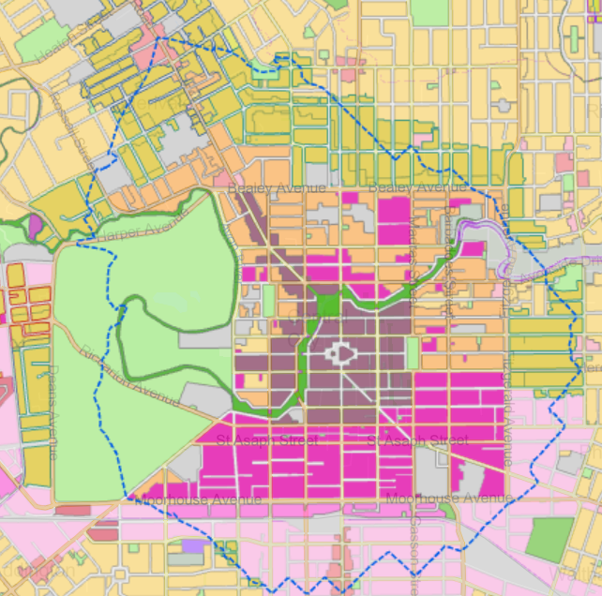
CBD Intensification Approach
Requirement to ‘realise as much development capacity as possible’ = no height limits within CBD
Requirement to enable ‘at least six storeys within at least a walkable catchment’ from the edge of the CBD
A 15 minute walking catchment (1.2km) around CBD adopted
Reflective of the significance of the central city and propensity for greatest walking distance
Height approach is two tier:
  Nearest to CBD enabled to 32m (ten storeys) – about the first 10min walking distance
  Next 5min distance – enabled to 20m (six storeys)
Notes:
NPS-UD direction – what it sets out to achieve
Requirements of us as a Tier 1 council (re MDRS) - what we have to do to meet the Medium Density Residential Standards
Timeline – refer Intensification Streamlined Planning Process – the timeline for giving effect to the NPS-UD has been brought forward by a year
Facts / assumptions underpinning housing sufficiency (what the demand/supply facts tell us)
What can be considered as qualifying matters?
What’s in and out of these plan changes – the givens and what can’t be changed
‘Well functioning urban environment’ – what it means and how we give effect to it
Importance of meeting high evidential thresholds to support proposed changes
What and how does it affect Christchurch (c.f. current District Plan)
Permitted level? (Query whiteboard notes: is this about how high can we go?
Relevant residential zones? (Query whiteboard notes: is this about what happens to these zones now?) How much info do we have on this? This might take more than 10 mins on its own?
E.g. 3 storeys becomes the permitted level (with no resource consent needed). Any application for 4+ storeys will need a RC, but the impact is only assessed as the difference between 3 and 4 storeys, rather than the impact of a 4 storey bldg.

Slide 22
Questions?
Do you have any questions about proposed residential approach?
    We can have some influence over these, however must give effect to regulation
Go to Slido.com and enter in the code: 762020
Alternatively, you can join by scanning this QR code

Slide 23
What controls and thresholds are we proposing?
Residential Zones
MDRS means residential zones are drastically simplified.
Two core zones current proposed, with localised precincts for local features, such as commercial centres, hilled sites, transition areas.
Medium Density Residential Zone
(all urban residential areas away from commercial centres):
Height: 3 storeys (no consent - MDRS); enabling consent at 4; increased evidence >5
Subdivision: 400m² vacant; zero with dwelling (MDRS)
Additional form controls: Street connectivity; storage areas; servicing
High Density Residential Zone
(around city centre & larger centres):
Height: 4 storeys (no consent - MDRS); enabling consent between 6-10; increased evidence >11
Subdivision: 300m² vacant; zero with dwelling (MDRS)
Additional form controls: Prescriptive form controls between 5-10 storeys

Slide 24
What controls and thresholds are we proposing?
Residential Zones – Framework
The NPS-UD restricts the consenting framework
Means there is an enabling framework proposed that fixes activity status, but increases Council discretion for consenting:
 | Permitted without consent | Enabling Consent
Medium density residential zone | MDRS (12m) – 3-4 storey | Up to 14m – about 4 storey
High density residential zone (without precinct) | Up to 14m – about 4 storey | Up to 10 storeys (32m)
Local Centre Precinct | Up to 14m – about 4 storey | N/A
Large Local Centre Precinct | Up to 14m – about 4 storeys | Up to 20m – 6 storeys
Town Centre Precinct
Emerging Metro Precinct

Slide 25
Changes to MDRS
Proposed changes to MDRS + beyond
PA – No recession plane control in front proportion of site @ >2 dwellings
PA – Street-facing gable end glazing not counted in 20% MDRS requirement
PA – additional building separation above 12m height
PA – ground floor habitable room
PA – storage areas, including internal storage
RDA, HRZ – form further controlled beyond six storeys, w increased setbacks & communal OLS
PA, HRZ – reduced OLS requirements for one bed or studio units
MDRS is most similar to Residential Medium Density Zone
Good design outcomes are usually achieved in this zone at present
Intention is to carry forward aspects of this successful framework with the revised system.

Slide 26
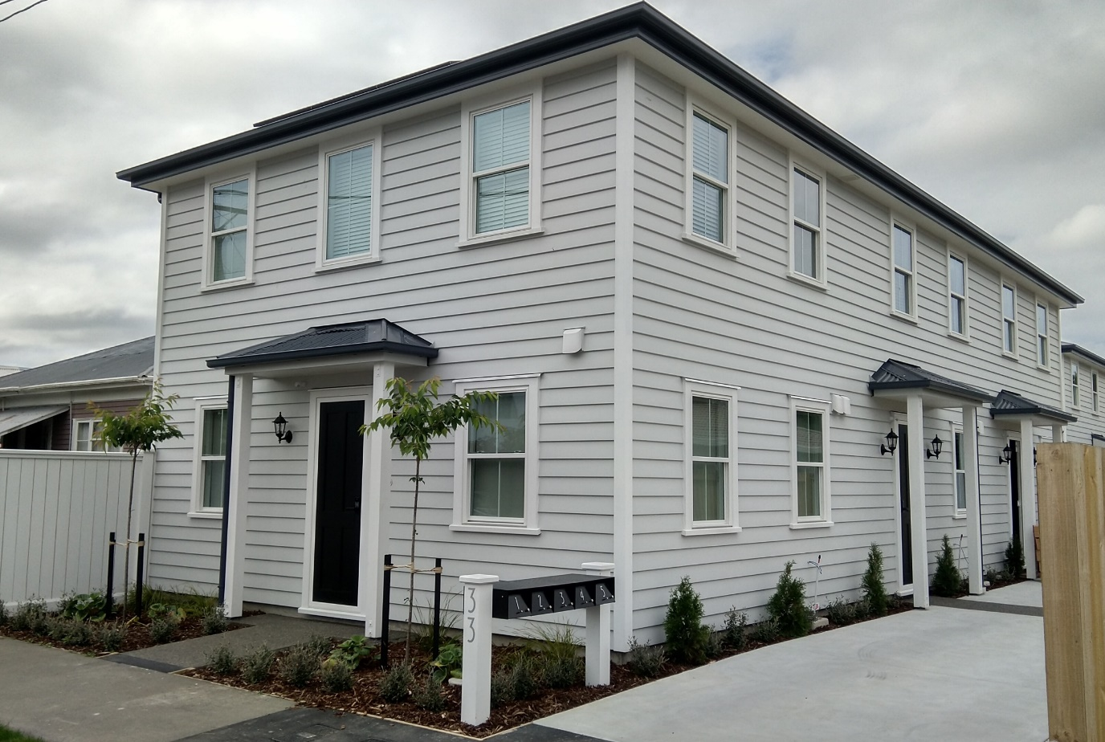
Medium Density Zone
MDRS is most similar to Residential Medium Density Zone
Good design outcomes are usually achieved in this zone at present
Intention is to carry forward aspects of this successful framework, with the revised system.

Slide 27
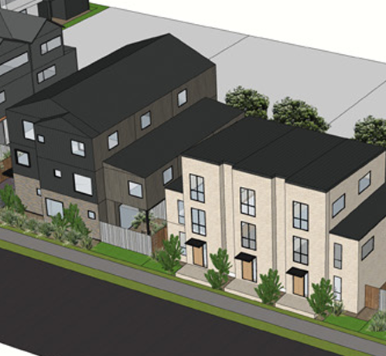
Four or More Units
Restricted Discretionary Activity, similar to current Residential Medium Density Zone
Assessed using Residential Design Principles
Key areas of focus are the way the houses address the street and access ways – the public areas of development.

Slide 28
Residential Design Principles (Revised)
Site layout and context
Relationship to the street and public open space
Built form and appearance
Residential amenity
Access, parking and servicing
Safety
Existing principles from RMD have been updated, with new principles proposed for the high density zone.

Slide 29
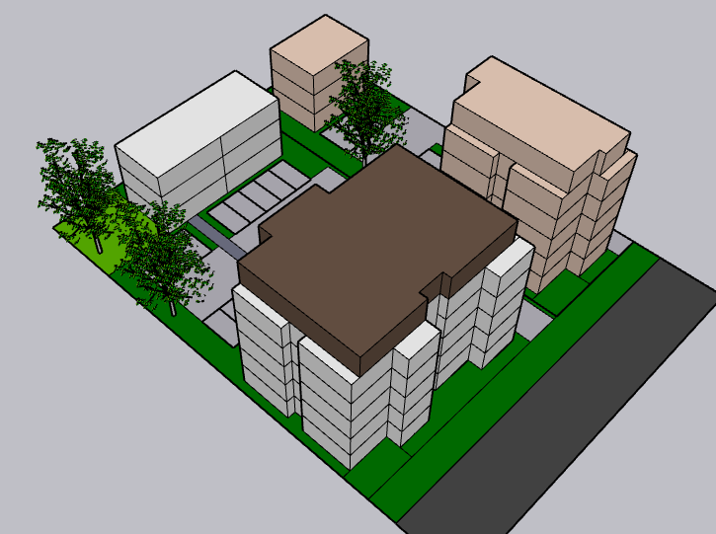
High Density Residential Zone
Buildings encouraged to locate at the street front (no recession planes on side boundaries up to 20m from the front boundary for 6 storeys or less)
Bulk of buildings frames the street, reduces privacy and overshadowing issues
More open space to rear allows for shared amenity and sunlight access
Allows taller buildings on small sites.

Slide 30
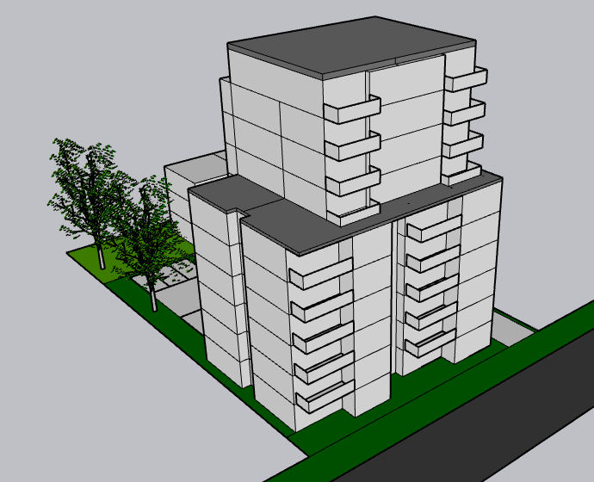
High Density Residential Zone
20m or 32m (6 or 10) storey limit
MDRS for the first 12m in height
Above this there are no recession planes (6m setback from side boundary applies instead)
Assessment matters seek to avoid overly long, tall buildings built sideways to the street.

Slide 31
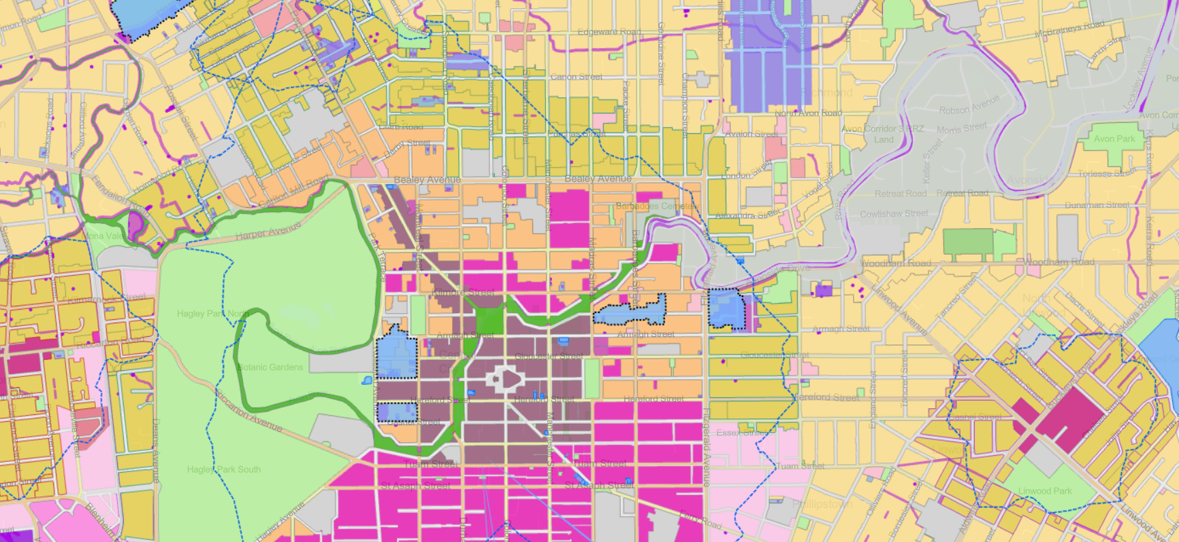
Residential Zones – Mapping Example
Status Quo*
3-4 Storeys
6 Storeys
10 Storeys
3-4 Storeys
No Limit
6 Storeys
6 Storeys
10 Storeys

Slide 32
Questions?
Do you have any questions about proposed controls?
    We can have some influence over these, but the rules are pretty tight
Go to Slido.com and enter in the code: 762020
Alternatively, you can join by scanning this QR code

Slide 33

Have your Say
Provide feedback until 13 May

Slide 34
What can you provide feedback on?
Name | Description
Draft Housing and Business Choice (Plan Change 14) | Shaping how and where we grow by enabling more development within the city’s existing footprint. We need to make these changes to give effect to the Government’s National Policy Statement- Urban Development (NPS-UD) and recent amendments to the Resource Management Act (RMA) that enable greater housing supply.
Draft Coastal Hazards (Plan Change 12) | Avoiding increased harm to people an property exposed to coastal hazards such as flooding and erosion.
Draft Heritage (Plan Change 13) | Creating new residential heritage areas to protect Christchurch’s special identity and character – we are proposing that 11 new residential heritage areas across the city be identified in the District Plan to protect Christchurch’s special identity and heritage values. Adding a total of 65 buildings, items and interiors to the Schedule of Significant Historic Heritage.
Draft Radio Communication Pathways (Plan Change 15) | Protecting our emergency radio communication airspace by controlling building heights/development that block it.
Notes:
We have talked about the various plan changes in passing. This table lays out the different jigsaw pieces and where each one fits in.
Note that a more detailed A3 Table is to be circulated to EMs on the different plan changes, and the different components of them (inform approach v influence approach).
Note that the Christchurch Transport Plan and Flood Management Areas work is progressing in parallel, but decisions to consult on and/or notify these pieces of work will be sought later. (7 April for the CTP, and post notification for the FMA)
This work is also being carried out in the context of the development of the Greater Christchurch Spatial Plan (GCSP), and the Otautahi Christchurch Plan (OCP)

Slide 35
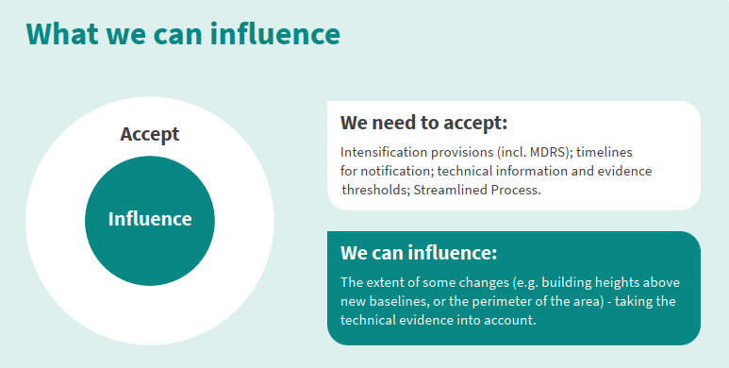
What can you provide feedback on?
Do you have any comments about other elements of the proposed Draft Heritage Plan Change?
Do you have any comments on the proposed Residential Heritage Areas?
ccc.govt.nz/haveyoursay

Slide 36
Decision making process
This is your easiest opportunity to give feedback
  Precedes formal notification of Draft Plan Changes before 20 August 2022
  All controls relating to MDRS have immediate legal effect once the Council notifies plan change

Slide 37
Questions?
Final chance for questions on the proposed residential intensification.
Any questions about consultation or how a decision will be made?
Go to Slido.com and enter in the code: 762020
Alternatively, you can join by scanning this QR code

Slide 38
Thanks for joining us for this webinar
To give feedback about the webinar: engagement@ccc.govt.nz
To discuss any of the issues with the team: planchange@ccc.govt.nz
Phone: 03 941 6886
Other webinars you may wish to attend
Commercial Intensification - Tuesday 3 May, 6.30pm–8pm

