Slide 1
Consent Hearing
Marette Wells
RMA/2020/1877
1 March 2022
kumon Fendalton

Slide 2
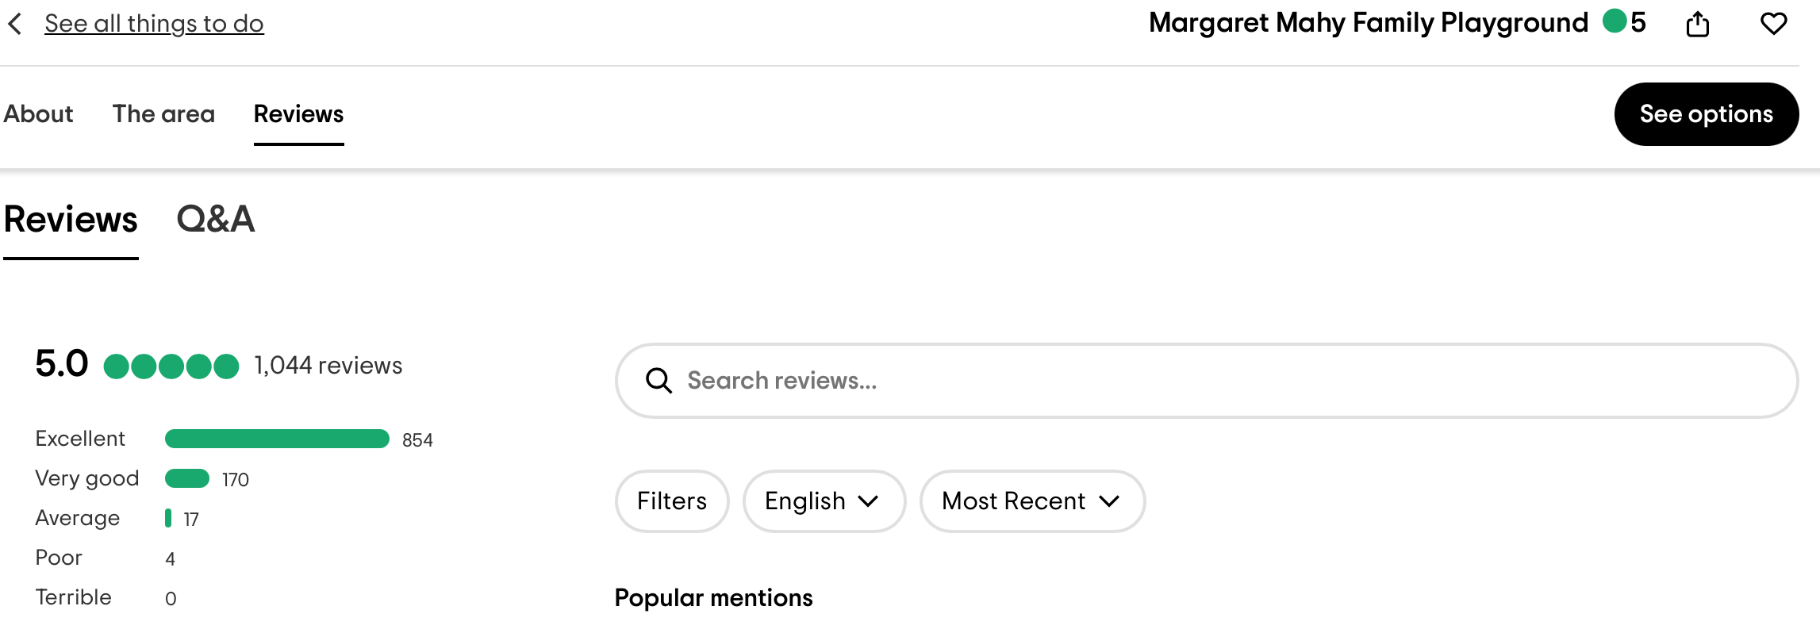
MARgaret mahy family playground
trip advisor

Slide 3
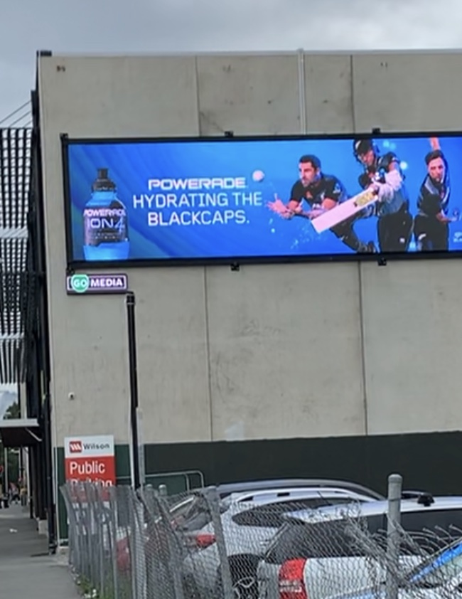
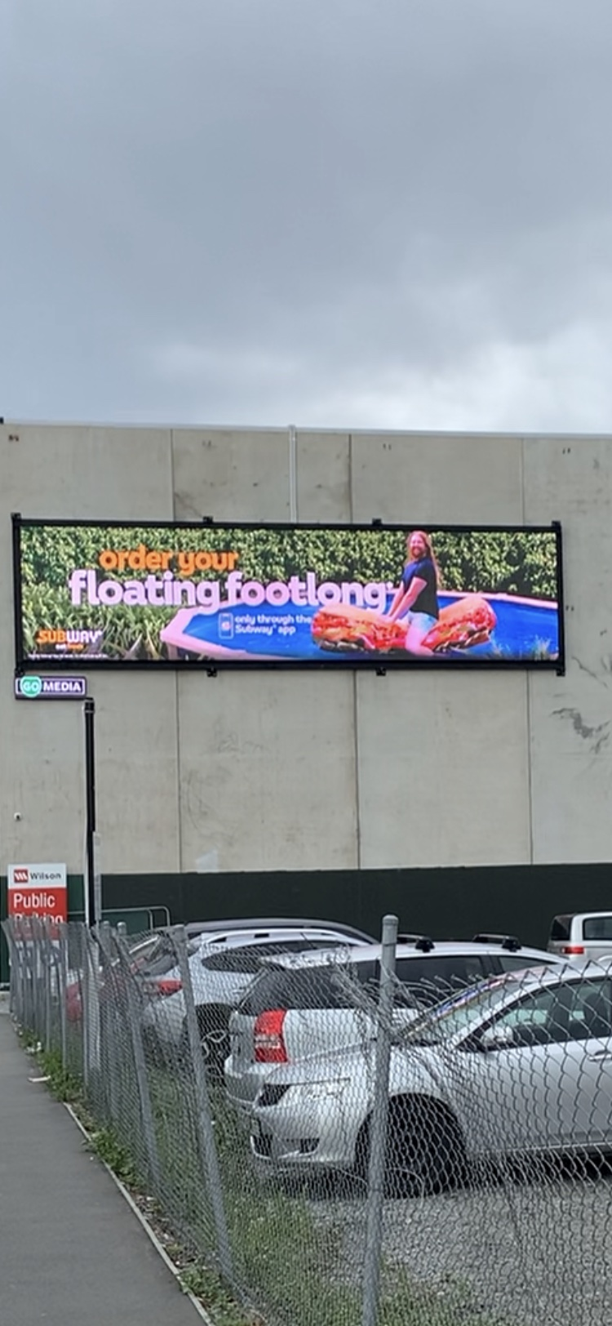
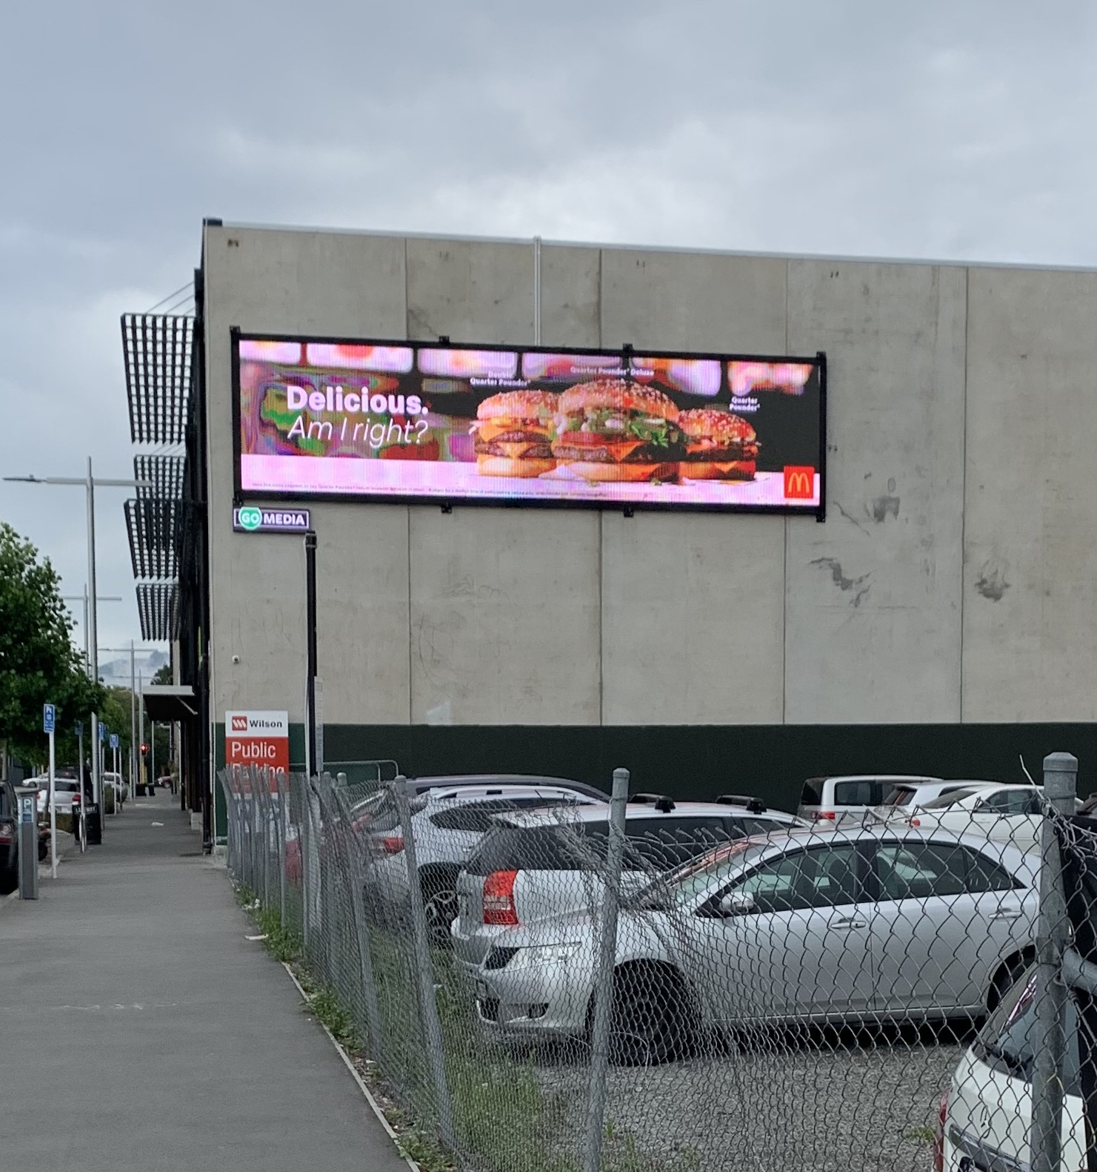
Existing ads

Slide 4
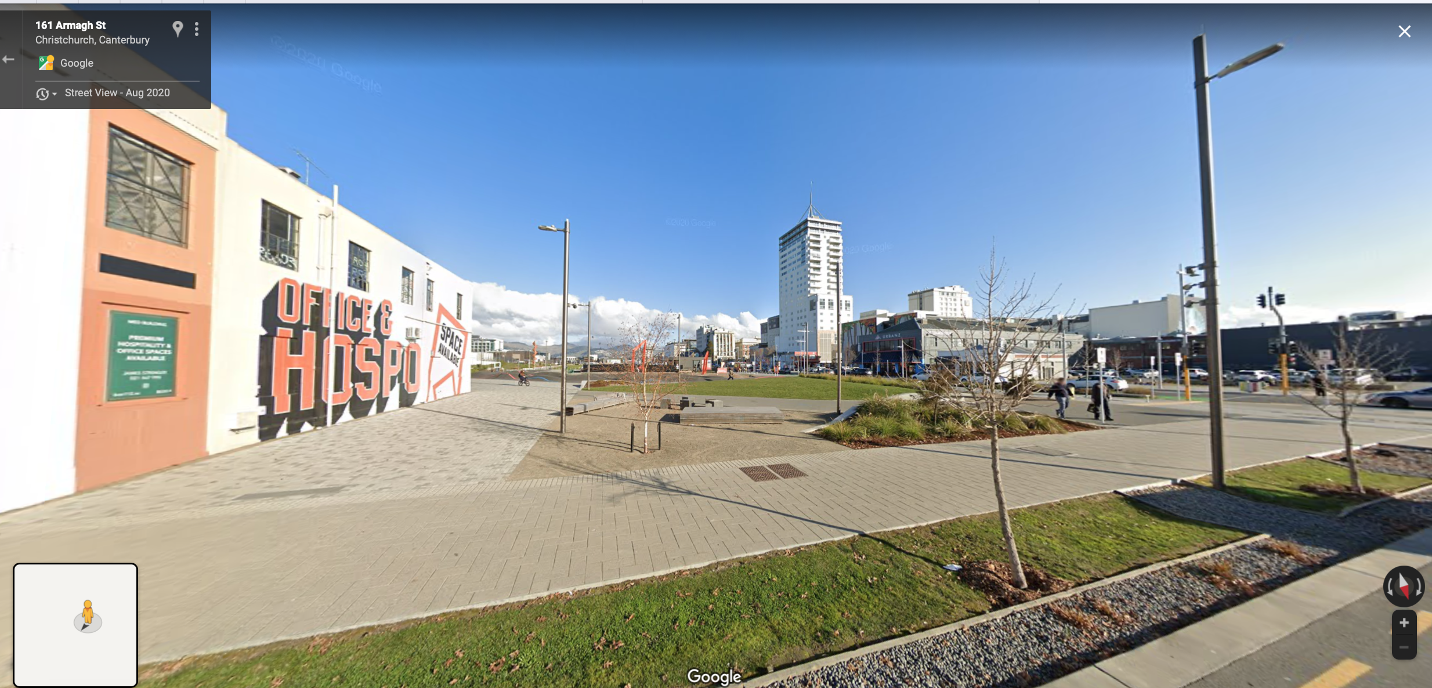
View from playground thru family area

Slide 5
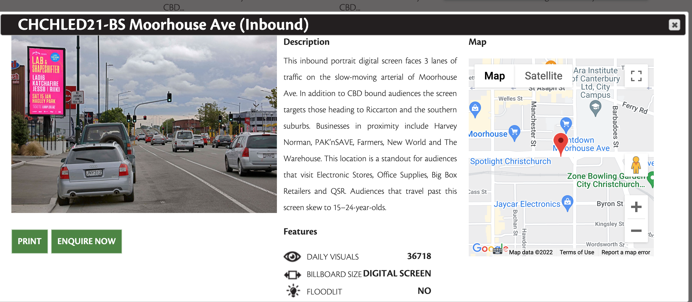

Slide 6
thank you
Marette Wells
RMA/2020/1877
1 March 2022
kumon Fendalton

