Slide 1
Transport, Health, and Inequalities
28th March 2019
Prof Jennifer Mindell
Professor of Public Health
William Evans Visiting Professor
j.mindell@ucl.ac.uk
@j_mindell

Slide 2
Outline of 2h session
How transport affects health
  Discussion
  Lecture
Transport and inequalities
  Age
  Sex
  Social inequalities
Health impact assessment
  Lecture
  Practical

Slide 3
Objectives
By the end of this session, you should be able to:
List the main impacts of transport on health
Discuss the main impacts of transport on inequalities in health
Health impact assessment

Slide 4
How does transport affect health?
Benefits
Problems
Synergies with other policies
[Inequalities]

Slide 5
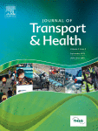
Landmark publications
Hannah J, Morton S, Watkins S. Health on the Move. Manchester: Public Health Alliance,1991.
Davis A. Road transport and health. London: BMA, 1997.
Mindell JS, Watkins SJ, Cohen JM (Eds.). Health on the Move 2. Policies for Health Promoting Transport. Stockport: Transport and Health Study Group, 2011. www.transportandhealth.org.uk
BMA. Healthy transport = Healthy lives. London: BMA, 2012.
Journal of Transport and Health 2014 -
    www.elsevier.com/locate/jth

Slide 6
Access to good, services, and people
Employment
Education
Shops
Health and other services
Social support networks
Recreation
Access vs Mobility

Slide 7
To think about
Mobility – ability to travel greater distances
Longer distances the norm but beneficial?
  supermarket 10miles away because local shops closed
  or healthcare without adequate public transport)

Slide 8
Recreation
Access to recreation:
  Leisure facilities
  Countryside
Travel as recreation:
  Scenery of the journey
  Mode of travel

Slide 9
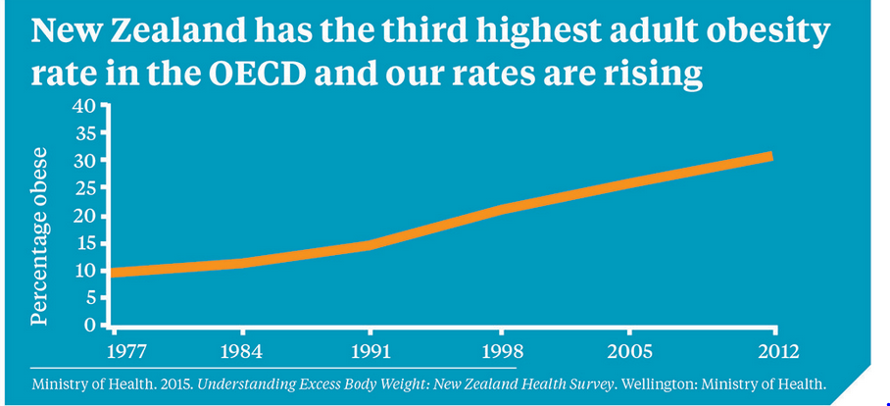

Slide 10
Physical activity, trends in walking and cycling & the obesity epidemic
In England, obesity:
  causes c.9,000 premature deaths annually,
  each losing nine years of life on average,
  and costs > £5bn per year

Slide 11
Health benefits of walking and cycling
49% of the adult population in New Zealand in 2013/14 were insufficiently active
  excluded active travel and work!
  https://www.health.govt.nz/your-health/healthy-living/food-activity-and-sleep/physical-activity/activity-levels-new-zealand
Notes:
Update figures

Slide 12
Health benefits of walking and cycling
Walking and cycling:
  can provide the same health benefits as sports or other exercise
  can increase cardiorespiratory fitness
  to work is as effective as a training programme and can fulfil the recommendations for physical activity.
Notes:
Update figures

Slide 13
Health benefits of active travel
Even in men from households with cars, men who walk or cycle to work have a lower rate of death from ischaemic heart disease than men who travel to work by car - with public transport users having in-between rates.
Studies in Denmark, China, and the UK have found substantial benefits of regular cycling on lower death rates.
Physically active men and women (including cyclists) have the explosive muscle power of someone 10 years younger
55-year-old cyclists had the aerobic fitness of people 30 years younger.

Slide 14
Obesity
Walking uses 4kJ (1kcal) /km/kg bodyweight, almost independent of pace.
Obesity risk:
  increases by 6% for each hour spent in a car per day
  falls by 4.8% for each km walked per day
Pedestrian-permeable street designs are associated with 6lb lower mean population weight than pedestrian-impermeable environments.
https://www.gov.uk/government/publications/obesity-and-the-environment-briefing-increasing-physical-activity-and-active-travel by Cavill N, Rutter H. Pub Nov 2013

Slide 15
Even in active people
Car commuters in Adelaide, Australia gained more weight over a 4yr study than non-car commuters. The effect was particularly pronounced when comparing those who had sufficient leisure time PA.
Sugiyama et al. Am J Prev Med. 2013;44:169–73.

Slide 16
Changes in mode of travel & BMI
Switching from car to active travel or public transport: BMI fell 0.32kg/m² (95% CI 0.05-0.60)
Switching from car to active travel: BMI fell 0.45kg/m² (95% CI 0.11-0.78)
Switching from active travel or public transport to car: BMI rose 0.34kg/m² (95% CI 0.05-0.64)
Martin A et al, JECH. 2015;69(8):753-61.

Slide 17
“Walking is transport”
In a 1994 paper by Jerry Morris, walking was described as ‘today’s best buy in public health’.
In 2004, Chief Medical Officer for England:
  “incorporating activity such as walking and cycling into daily life is the easiest way to be physically active.”

Slide 18
Benefits of walking and cycling
Activity
Age-independent
Affordable
Access
Air quality
Flexible
Mental health
Less sick leave
Longevity

Slide 19
Health impacts of Air pollution
Obesity
Neuro-developmental disorders
Neuro-degenerative diseases
Asthma
Other respiratory disease
Heart attacks
Stroke
Lung cancer
WHO: 7,000,000 deaths pa globally from air pollution exposure

Slide 20
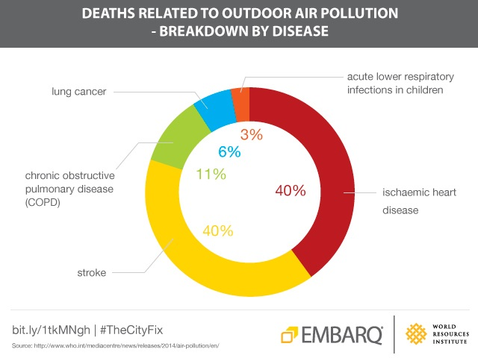
www.who.int/mediacentre/news/releases/2014/air-pollution/en/

Slide 21
Health impacts of air pollution in New Zealand
In 2012, air pollution from human-made PM₁₀ was associated with an estimated:
  1000 premature deaths
  520 extra hospital admissions for cardiovascular and respiratory diseases
  1.35 million restricted activity days (when symptoms were sufficient to prevent usual activities, such as work or study).
Ministry for the Environment and Statistics New Zealand. 2014. New Zealand's Environmental Reporting Series: 2014 Air domain report.

Slide 22
Air pollution from motor vehicles in New Zealand in 2006 accounted for:
Health impacts
  256 premature deaths
  142 cardiorespiratory hospital admissions
Social costs
  $942 million (22% of the social costs of air pollution from human sources in New Zealand)
  $233 per person
Kuschel et al. 2012. Updated Health and Air Pollution in New Zealand Study. Volume 1: Summary report. www.hapinz.org.nz

Slide 23
Air Pollution & Climate Change
Motor transport a major source of emissions of pollutants:
  CO, PM, NOx,
  VOCs: e.g. benzene,1,3-butadiene, polycyclic aromatic hydrocarbons (PAHs)
Photochemical reaction in sunlight between NOx and VOCs to form ozone
Cardio-respiratory effects

Slide 24
Main sources of emissions in New Zealand
Nationally in 2015, residential emissions, primarily burning wood for home heating, were the main human-generated source of PM₁₀ (25%), PM_{2.5} (33%), & CO (38%).
12% of PM₁₀ from dust from unsealed roads
On-road vehicles largest single source of NO_{x} (39% of human-generated emissions, 70% of which was from diesel vehicles).
https://www.stats.govt.nz/indicators/air-pollutant-emissions

Slide 25
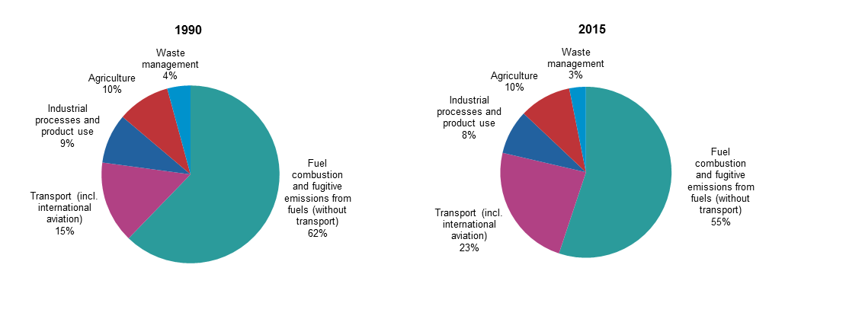
Greenhouse gas emissions by source sector, EU-28 1990 and 2015
http://ec.europa.eu/eurostat/statistics-explained/index.php/File:Greenhouse_gas_emissions,_analysis_by_source_sector,_EU-28,_1990_and_2015_(percentage_of_total)_new.png

Slide 26
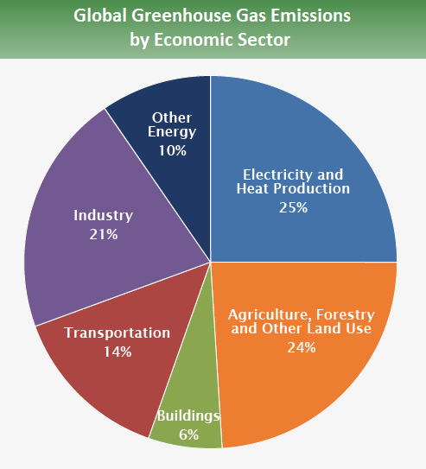
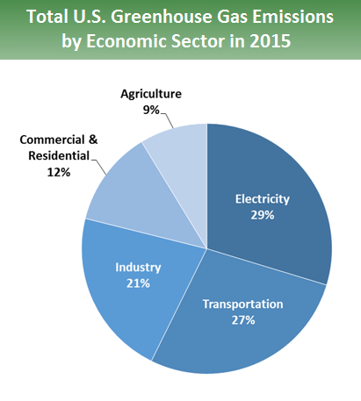
Greenhouse gas emissions by sector
IPCC 2014

Slide 27
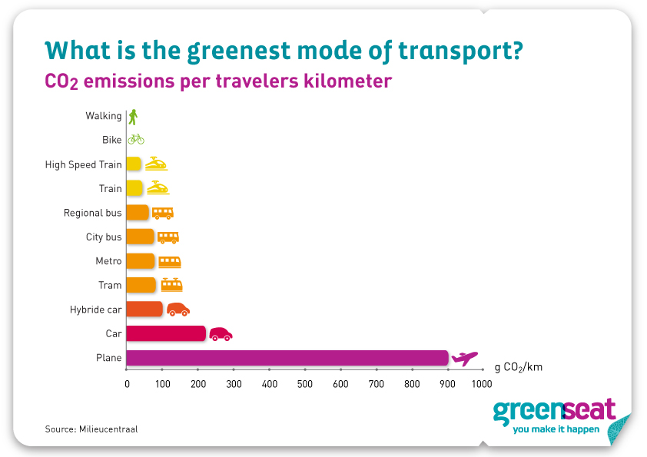

Slide 28
Injuries – New Zealand, 2016
328 deaths in 286 fatal road crashes
12,456 people injured in 9,682 injury crashes
i.e. on average, 1 death almost every day, and 34 injuries per day from motor vehicle crashes
https://www.transport.govt.nz/mot-resources/road-safety-resources/road-deaths/annual-number-of-road-deaths-historical-information/

Slide 29
Is cycling dangerous?
Like-for-like comparisons across travel mode by age and sex

Slide 30
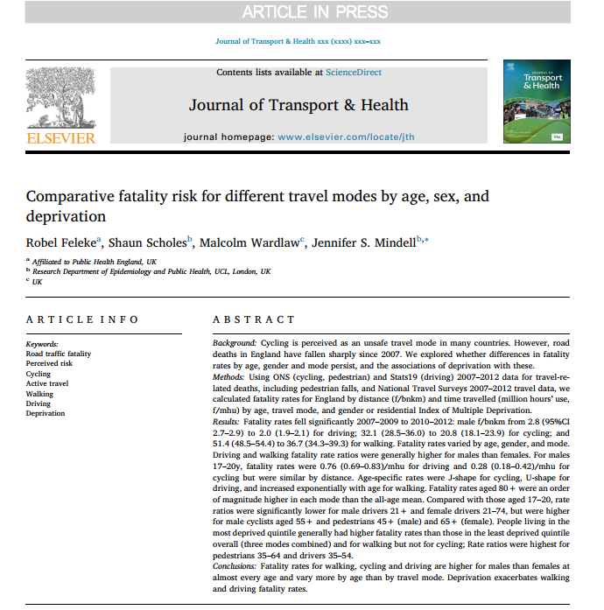

Slide 31
Fatality rates by time spent travelling by age, males 2007-12, all ages & 17+

Slide 32
Fatalities per million hours by mode
Aged 17-69, 2007-2012
Males
Females
17+
Notes:
Higher in males than females
Driving > cycling in males <21;
Driving signif < cycling aged 30+ (M & F)
Driving > walking in males & females<30
Increase in risk cycling:50+ M, 60+ F
Walking 65+ M

Slide 33
Fatalities per million hours travel by mode
Aged 70+, 2007-2012
Male
Female
Notes:
Rates separate in older men but overlap more for older women (NS diff 70+)

Slide 35
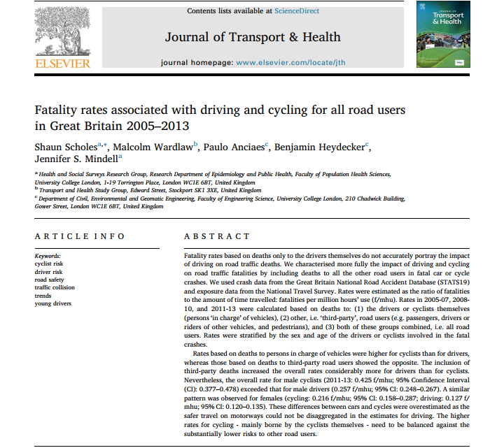

Slide 36
Default national speed limit of 20mph (30kph) on residential streets
https://www.gov.uk/government/publications/20-mph-speed-limits-on-roads
http://www.20splenty.org/30kmh

Slide 37
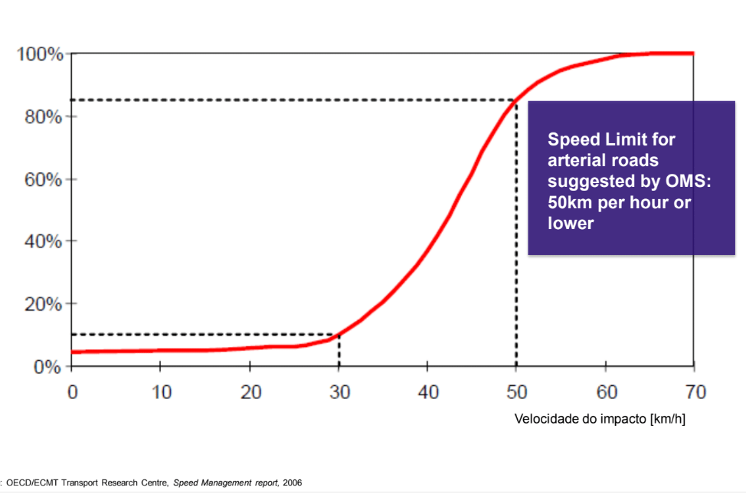
Fatality risk related to speed (kph)
mph
20
31

Slide 38
Community severance - the ‘barrier’ effect of busy roads

Slide 39
Quigley & Thornley, 2011
Report to the NZ Transport Authority
“Separation of people from facilities, services and social networks they wish to use within their community; changes in comfort and attractiveness of areas; and/or people changing travel patterns due to the physical, traffic flow and/or psychological barriers created by transport corridors and their use.”

Slide 40
Stress, social support, and community severance
Stress adversely affects health
Transport and stress (e.g. noise, driving, lack of transport options)
Perceived danger
Community severance
Social networks
Use of streets as social spaces
Children’s independence
Mindell JS, Karlsen S. Community severance and health: What do we know? J Urban Health. 2012;89:323-46.

Slide 41
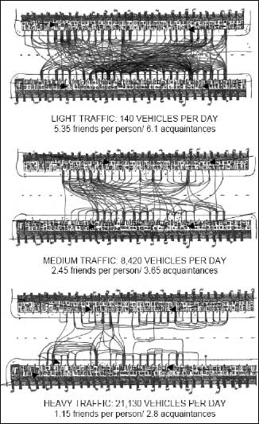
Community severance
Appleyard and Lintell,
San Francisco

Slide 42
Noise pollution from busy roads
Raised blood pressure
Interference with concentration and with sleep
Disruption of education

Slide 43
Spatial planning
Urban sprawl increases distances to be travelled
Mixed development reduces them
Pedestrian permeability
Roads vs streets
Parks and green space ↑ walking
Green streets ↑ walking

Slide 44
Other impacts on health
Loss of land e.g. Los Angeles:
  1/3 of LA area is roads
  1/3 of LA land is car parking.
Planning blight
Tarmac replacing greenery
Effects on heat islands, run-off, water contamination, mental wellbeing, physical activity

Slide 45
Parking
Parking distorts the value of land, property and services in favour of car owners.
It enforces the dominance of the car in our built and social environment.
It creates an inhospitable environment for pedestrians.
Parked cars can provide a hazard to everyone and especially to older people, children and visually impaired people

Slide 46
Inequalities in access to transport modes
Think about inequalities in BENEFITS as well as HARMS of transport
Affordability
Accessibility
Availability
Acceptability
Appropriateness

Slide 47
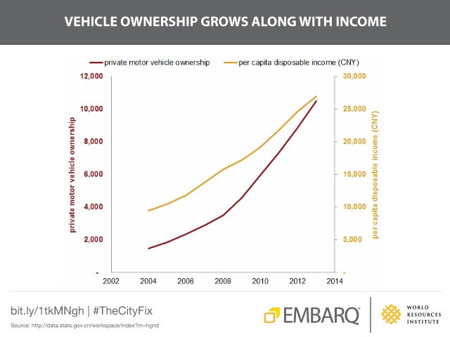
http://thecityfix.com/blog/china-clean-air-challenge-health-impacts-transport-emissision-pollution-sustainable-su-song/

Slide 48
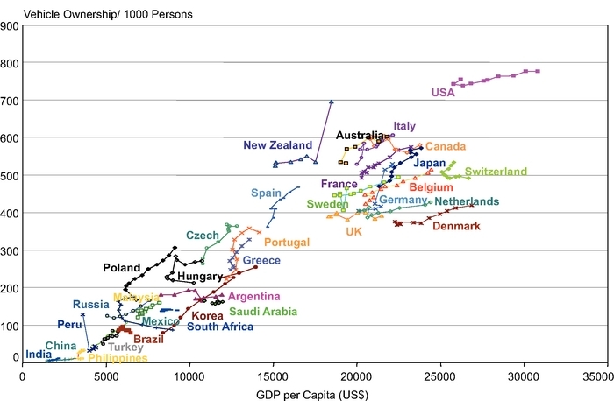
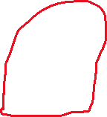
Population vehicle ownership rates globally by per capital GDP

Slide 49
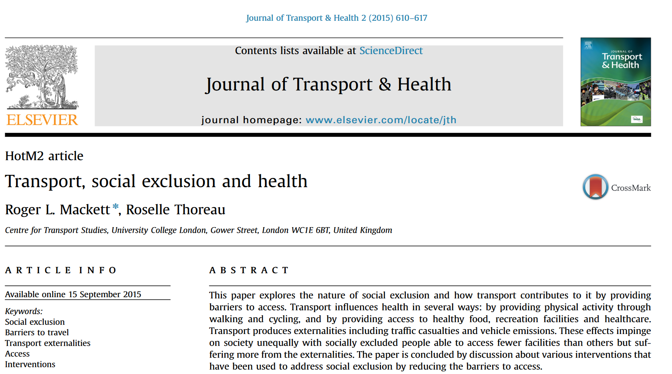
Inequalities and social exclusion
Access
  Poverty
  Gender
  Age
  Rurality
Air pollution
Noise pollution
Injuries & fatalities
https://www.sciencedirect.com/science/article/pii/S2214140515006775

Slide 50
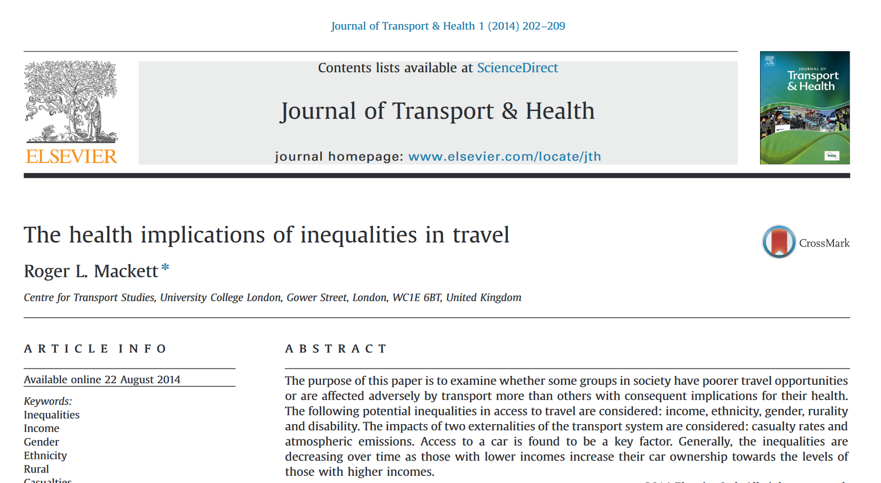
Inequalities
Age
Sex
Social
  within countries
  between countries
e.g. https://www.sciencedirect.com/science/article/pii/S2214140514000504

Slide 51
Transport and inequalities in adverse effects
Age:
  young & old disproportionately in poorer groups
  less car access
  more exposure & more susceptibility
Gender: Women less car access than men
  Girls less independent mobility than boys
Socio-economic
  within countries
  between countries (eg effects of climate change)

Slide 52
Health inequalities from busy roads
Air pollution
Poorer people:
  More exposed to air pollution from motor traffic
  More susceptible to health impacts of pollution

Slide 53
Crossing times
Pedestrian lights crossing times in UK, Australia, USA assume walking speed 1.2m/s (4.3 km/h)

Slide 54
Walking speed by age

Slide 55

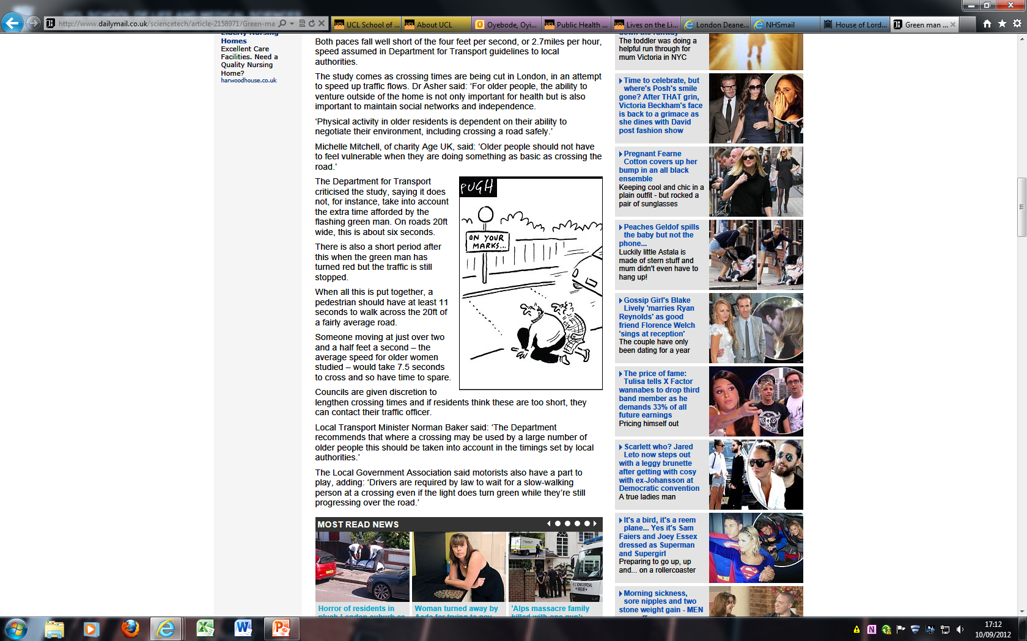
Pelican racetracks!
Green man crossings are a death trap for any pensioner not nimble enough to walk at 4ft per second, warn researchers
Paper published online June 2012:
Asher L, Aresu M, Falaschetti E, Mindell JS. Most older pedestrians are unable to cross the road in time: a cross sectional study. Age Ageing.2012;41:690-4

Slide 56
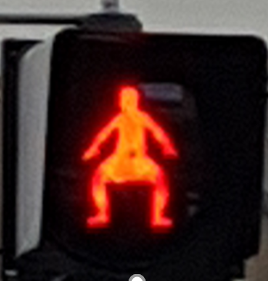
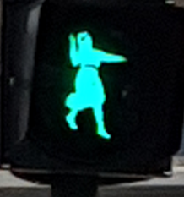
Living Streets Campaign
Used HSE 2005 timed walk data to show road crossings are set too quickly for more than 3 in 4 older people.
Reduce the assumed walking speed to 0.8 m/s, so most older people could cross comfortably
Currently 1.2 m/s
Men 65+
0.9 m/s (3.2 km/h)
Hey Mr Boris
https://www.youtube.com/watch?v=lpwboQxVJtg
Women 65+
0.8 m/s
(2.9 km/h)

Slide 57
Some publications: Transport & inequalities
Mackett R. The health implications of inequalities in travel. J Transp Health. 2015;1(3):202-9.
  Large differences exist in the volumes of travel by various groups in society.
  These differences are decreasing over time.
  There are large differences in access between urban and rural areas.
  Cultural factors contribute to differences in access.
  Casualty rates and vehicle emissions impact more on the poor than the rich.
Mackett RL, Thoreau R. Transport, social exclusion and health. J Transp Health. 2015;2(4):610-7.
www.sciencedirect.com/science/article/pii/S2214140515006775

Slide 58
Boniface S, Scantlebury R, Watkins SJ, Mindell JS. Health implications of transport: Evidence of effects of transport on social interactions. J Transp Health. 2015;2(3):441-6.
Lack of access to transport can lead to social exclusion and poor social capital, which impact on health.
Walkable built environments promote social capital and social cohesion, both of which benefit health.
Traffic can lead to smaller social networks, which impacts on physical and mental health.
See: Holt-Lunstad J et al.(2010) Social Relationships and Mortality Risk: A Meta-analytic Review. PLoS Med. 7: e1000316.

Slide 59
Risks and benefits of travel - cycling
Compared with car users, the estimated annual change in mortality of the Barcelona residents using Bicing (n=181 982)
  0.03 deaths from road traffic incidents
  0.13 deaths from air pollution.
  12.46 deaths avoided by physical activity
  12.28 deaths avoided pa: Benefit:Risk ratio 77
  Annual CO₂ emissions reduced by >9m kg
Rojas-Rueda D et al. The health risks and benefits of cycling in urban environments compared with car use: health impact assessment study. BMJ 2011;343:d4521 http://dx.doi.org/10.1136/bmj.d4521

Slide 60
Importance of location
Warsaw:
  Air pollution, noise and injuries: health risk of 58,000 DALYs pa
  Physical activity: health benefit of 17,000 DALYs pa
Tainio M. Burden of disease caused by local transport in Warsaw, Poland. J Transp Health. 2015;2(3):423-33.
Also: World Health Organization. Health economic assessment tool (HEAT) for cycling. WHO, 2008. www.heatwalkingcycling.org/
Caulfield B, Deenihan G. Estimating the health economic benefits of cycling. J Transp Health. 2014;1(2):141-9.

Slide 61
Transport and health
Access
Physical activity
Air pollution
Injuries
Noise
Community severance
etc.

Slide 62
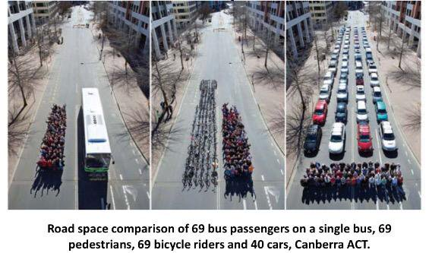
Transport = Moving people, not cars
(AND FREIGHT NOT LORRIES)

Slide 63
Policy response: Reduce car use
↑ Active travel – ↑ physical activity
↓ Emissions of pollutants
↓ Serious injuries
↓ Transport inequalities
Spatial planning that does not assume or encourage car use

Slide 64
Health inequalities from busy roads
Social isolation
Poor - worse health
  less able to walk or cycle
  Less likely to own a car
  Less likely to afford public transport
Frail, elderly, disabled: less able to cross the road (bus stops)
Fewer other options for safe spaces to meet and socialise (old, young)

Slide 65
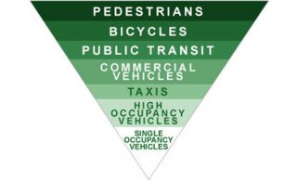
Transport planning hierarchy
Source: City of Portland Climate Action Plan, 2009.

Slide 66
Sir Liam Donaldson
Chief Medical Officer
“The potential benefits of physical activity to health are huge. If a medication existed which had a similar effect, it would be regarded as a ‘wonder drug’ or ‘miracle cure’.”
(Annual Report of the Chief Medical Officer 2009, DH, March 2010)

Slide 67
Useful resource
Faculty of Public Health. Local action to mitigate the health impacts of cars.
https://www.fph.org.uk/media/1386/briefing-statement-impact-of-cars.pdf

Slide 68
Reading
Nicholl JP, Freeman MR, Williams BT. Effects of subsidising bus travel on the occurrence of road traffic casualties. J. Epid. and Community Health, 1987;41:50-4.
Asher L, Aresu M, Faslaschetti E, Mindell JS. Most older pedestrians are unable to cross the road in time: a cross sectional study. Age Aging. 2012;41:690-4.
Coronini-Cronberg S, Millett C, Laverty AA, Webb E. The impact of free older persons’ bus pass on active travel and regular walking in England. Am J Public Health. 2012;102:2141-8

Slide 69
Further reading
  Godlee F. Transport: a public health issue. BMJ. 1992;304:48-50.
  Mindell J, Sheridan L, Joffe M, et al. HIA as an agent of policy change: Improving the health impacts of the Mayor of London’s draft transport strategy. J Epidemiol Community Health. 2004;58:169-74.
  MacDonald JM et al. Using public transport increases physical activity. Am J Prev Med. 2010;39:105-12.
  Rojas-Rueda D, et al. Health benefits of cycling. BMJ. 2011;343:356.
  Social Exclusion Unit. Making the Connections: Final report on transport and social exclusion. London: ODPM, 2003.

